Slide 1
ParcelMap BC Adoption Working Group
Workshop #26
March 17th 2021
10:00am to 12:00 pm
Remote Session
Brian Greening AWG Chair
Director, ParcelMap BC Products, LTSA
Steve Mark AWG Vice-Chair
Director of Operations, ICI Society

Slide 2
Agenda
Welcome / Opening Remarks | 10:00 am
Housekeeping: (15 min) AWG Participants Update: Communications Update: Sub-Group Updates: Team Alignment: Updates & Workshop Target Team Land Records: Updates & Workshop Target Team Province: GeoBC Updates | 10:05 am
ParcelMap BC Status Update: (20 min) Operations Status & Projects / Initiatives Update Spatial Improvements (See Completed & Targeted Areas and latest Assessment) Adopter Status Update (See Latest Report) | 10:20 am
ICI Society Virtual Café – Summary/Outcomes: (20 min) ParcelMap BC Deep Dive Workshop: Overview & Feedback Follow-up Attendee Survey Results | 10:40 am
Adopter Issues Log: (20 min) Triage New Issue(s) Review & Set Priorities for the AWG | 11:00 am
Implementation Partners: Program Review (20 min) Partner Updates Program Objectives / Terms of Reference Review Partner Landscape: Gaps or Opportunities to Grow? | 11:20 am
Transition Planning Resources (10 min) Overview of where to find the resources Revised definitions of ParcelMap BC and Adoption | 11:40 am
Future Workshops (5 min): Next Up: April 21, May 19, etc… Session Focus / Topic(s) | 11:50 am
Open Questions, Feedback & Wrap-Up | 11:55 am

Slide 3
AWG Housekeeping
AWG Participants Update:
New Observer: Cara Foden (Planning Technician, City of Port Alberni)
Departing Participant: Kenna Bilek (Provincial Coordinator, Land Survey & Tenure, Prop & Land Mgmt, MoTI)
Communications Update:
ParcelMap BC Newsletter Updates (Subscribe here)
Sub-Group Updates:
Team Alignment:
Updates & “Data Alignment Workflows” Workshop
Team Land Records:
Updates & “Land Records Integration” Workshop
Team Province:
Updates (?)

Slide 4
ParcelMap BC Ops: February 2021 Stats
SPDS Defect Rate (Reported)
YTD | Curr. Month
5% | 4%

Slide 5
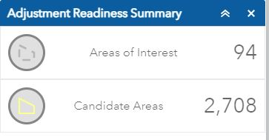
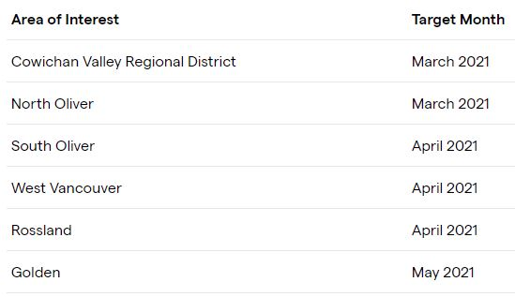
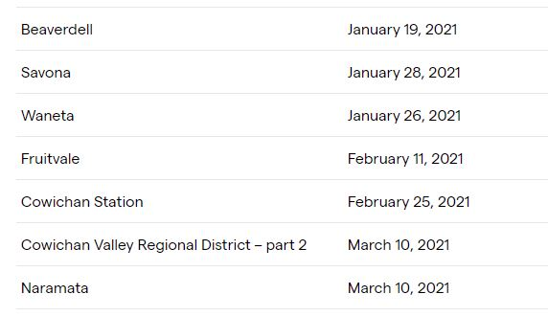
ParcelMap BC Ops: Latest Stats
Spatial Improvements:
Latest assessment March 10th 2021
Targeted: Completed (Latest only – full list here):

Slide 6
ParcelMapBC: Tier 2 Customer Support – February 2021
Number of Cases (YTD - 2021) | Number of Cases (Feb. 2021) | Median Turnaround Time (YTD - 2021)
137 | 63 | 1.7 days

Slide 7
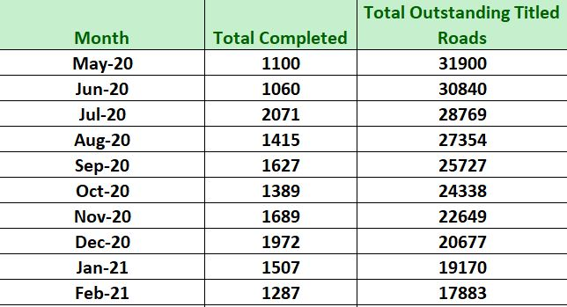
Active Road Parcels Project
Background:
Active PIDs identified as ‘road’ through assessment by the LTSA excluded from scope during the initial build of ParcelMap BC.
Operational Update – February 2021:
Initial Projection assumes ~33000 ‘Titled Roads’ initially.
Estimated completion date April, 2022.

Slide 8
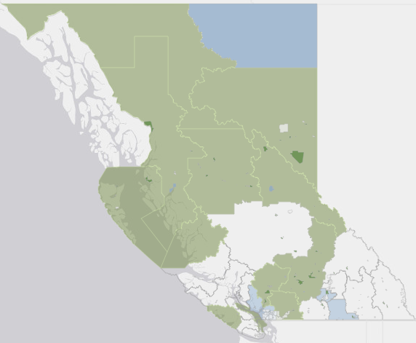
Adopter Dashboard: February 28th 2021 Footprint
Current Adopters (78):
NEW Local Governments | NEW Other Adopters
North Coast Regional District
Central Coast Regional District
Village of Port Clements
Village of Masset
Full list available here
LIVE map
Green = Adopted
Blue = Transitioning

Slide 9
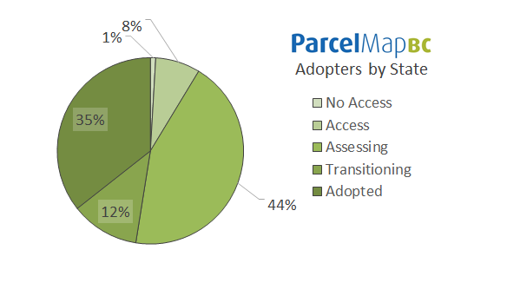
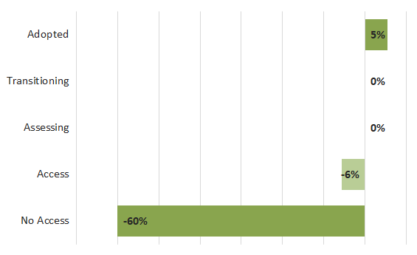
Adopter Dashboard: February 28th 2021 Report
Full details here

Slide 10
ICI Society Operations Update
Virtual Cafés for 2021
“ParcelMap BC Deep Dive”
Wed Feb 24th 9:30a – 12:00p -– Over 130 attended!
AWG attendees – What did you think?
GROUP: Overview & Feedback
Follow-up Survey to Workshop Attendees
Overview and Results

Slide 11
Follow-Up Survey: ParcelMap BC Deep Dive Community Workshop
Purpose: To help plan and prioritize bringing valuable content to support organizations with making the most of what ParcelMap BC has to offer.
Workshop held on February 24, 2021
Follow-up survey from LTSA and distributed by ICI Society
130 workshop attendees polled
26 responses collected – approximately 20% response rate

Slide 12
Questions on the survey
Q1. Contact Information
Q2a. Did the workshop meet your expectations?
Q2b. Reason(s) for the ranking?
Q3a. Based on your understanding from the workshop, where does your organization fall in terms of ParcelMap BC Adoption?
Q3b. Comment(s) on your current state?
Q4a. What topic did you find most useful?
Q4b. Was there a specific topic that stood out?
Q5. Is there a topic you think needs a further workshop?
Q6. What topics would you like addressed in future workshops that were not covered in this workshop?

Slide 13
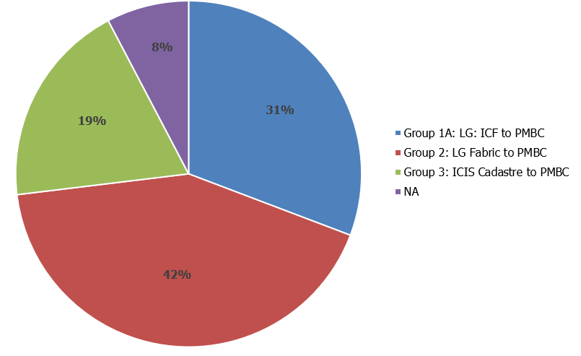
Respondents by Adopter Group

Slide 14
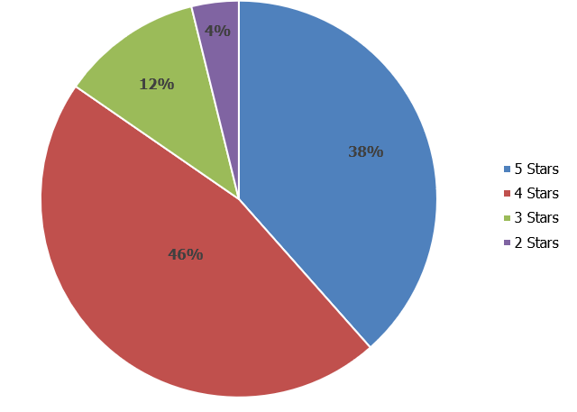
Q2a. Did the workshop meet your expectations?
Weighted Average: 4.2

Slide 15
Q2b. Reasons for the workshop rating
“Great information while adopting.”
“The QA/QC process elaboration built my confidence enough that I am now exploring implementing it in my organization.”
“Detail of process gives increased confidence in ParcelMap BC.”
“Lots of in-depth detail for processes followed by the ParcelMap BC team to ensure an accurate and high-quality product.”
“Very informative, enjoyed the detailed walkthrough of the Parcel Fabric corrective
process.”
“Low level explanations and transparency of processes.”

Slide 16
Q3a. Where does your organization fall in terms of ParcelMap BC adoption?

Slide 17
Q3b. Comments on ParcelMap BC Transition State
“I love the one source for a Provincial Cadastre.”
“Would like to use the ParcelMap BC. Need help and backing from mgmt. and integration with Tempest.”
“Have adopted the ParcelMap BC internally, working on an external dataset for public facing.”
“We are still working on our integration with our land management system.”

Slide 18
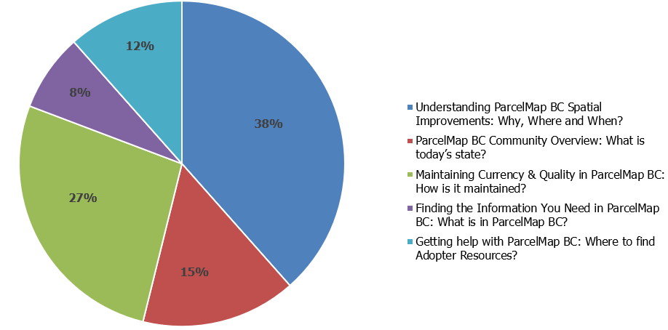
Q4a. Which topic did you find the most useful?

Slide 19
Q4b. Was there a specific topic that stood out?
“Getting help with ParcelMap BC: Where to find Adopter Resources?”
“The standards for submitting additional control points.”

Slide 20
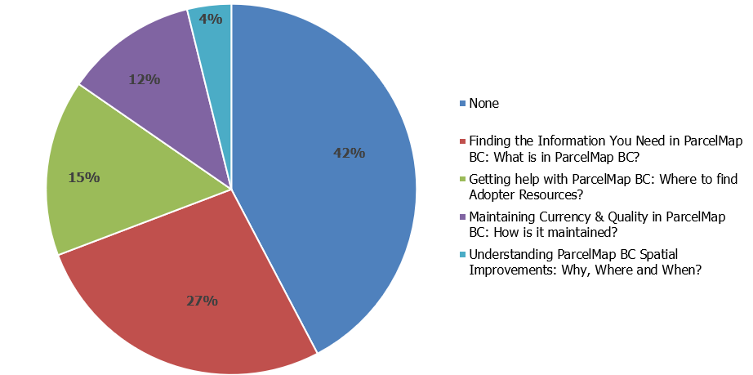
Q5. Is there a topic that needs a further workshop?

Slide 21
Q6. What topics would you like addressed in future workshops that were not covered in this workshop?
“Demo of the Data Alignment tools! How to integrate Parcel Map BC with Vadim.”
“More user stories on how to overcome things like integrations with financial and land management software packages, maintaining non-folioed parcels, creative labeling solutions, etc.”
“How to overcome issues with parcels that are not assigned PIDs (i.e. strata) .”
“User case examples of adoption/adjusting internal workflows to accommodate/specifics about ParcelMap BC schema and potential field mapping/systems automation.”

Slide 22
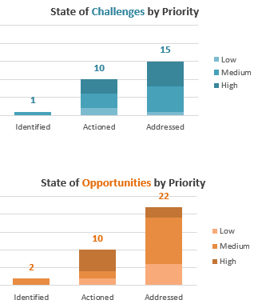
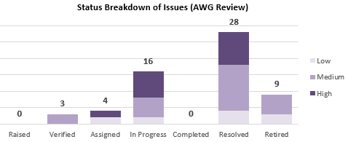
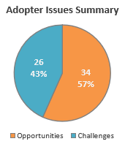
Adopter Issues Log: Status & AWG Priorities Review
Status see AWG page:
Changes / Updates:
New Issue(s): None
Review & Set Priorities for the AWG:
GROUP: Lots to review – 23 Issues in Verified, Assigned or In Progress

Slide 23
Implementation Partners:
Implementation Partner Program Review
Partner Updates
Esri Canada / Harterra Spatial Systems / Urban Systems
Program Objectives / Terms of Reference Review
Why did we start this & are we hitting the mark?
Partner Landscape: Gaps or Opportunities to Grow?
Group: Are there specific interest areas or user groups not covered?
Group: Do we need to recruit more Implementation Partners?

Slide 24
ParcelMap BC Adopter Resources Update:
Transition Planning Resources toolkit:
Where to find & Overview of the “toolkit”
Revised Adopting ParcelMap BC page with Resource Matrix (Assessing / Transitioning / Collaborating)
Updated Adoption Resources Landing Page
Transition Planning Resources toolkit:
Transition Planning Situation Assessment Template
Transition Project Management Guide
Transition Business Case Presentation Template
Large Municipality Focus Group (LMFG) Case Study

Slide 25
ParcelMap BC Adopter Resources Update:
Revised definitions of ParcelMap BC and Adoption:
Parcelmap BC Definition: ParcelMap BC is the current, complete and trusted mapped representation of titled and Crown land parcels across British Columbia, considered to be the point of truth for the graphical representation of property boundaries. It is not the authoritative source for the legal property boundary or related records attributes, this will always be the plan of survey or the related registry information.
Adoption Definition: The adoption of ParcelMap BC is a milestone, where ParcelMap BC is recognized and referenced as the current, complete and trusted mapped representation of titled and Crown land parcels in BC, graphically and for identifying attribution, by the Adopter organization, which include local governments and major utilities in the Province, among others.
Adopter Checklist: My organization recognizes & references ParcelMap BC as the current, complete and trusted mapped representation of titled and Crown land parcels in BC for:
the graphical representation of property boundaries, and
the related identifying attribution.
Where my organization uses parcel mapping in our workflows, it is based on, derived from or leverages a 3rd party's parcel mapping based on or derived from ParcelMap BC for the graphical boundaries and identifying attribution.

Slide 26
Future Workshops
Workshop #27 Date & Logistics
Wednesday April 21st (10:00a – 12:00p Webconference)
Possible Topics:
What’s next??
- Review Issues Log after today’s updates to prioritize?
- Do we need a survey?
Subsequent Workshop Dates:
May 19th, June 16th, Summer break?

Slide 27
Wrap-Up
Group Feedback?
Open Questions?

